Slide 1
Concurrency
Lecturer: Ngo Huy Bien
Software Engineering Department
Faculty of Information Technology
VNUHCM - University of Science
Ho Chi Minh City, Vietnam
nhbien@fit.hcmus.edu.vn

Slide 2

Objectives
To differentiate among multiprogramming, multiprocessing, multitasking and multithreading.
To create threads.
To create locks.
To create asynchronous methods.

Slide 3

Contents
Processes.
Multiprocessing.
Threads.
Concurrency vs. Parallelism.
Asynchronous Programming.

Slide 4

References
Per Brinch Hansen (1970). The Nucleus of a Multiprogramming System.
Joseph Albahari and Eric Johannsen (2020). C# 8.0 in a Nutshell: The Definitive Reference. O'Reilly Media.
RB Whitaker (2017). The C# Player's Guide. Starbound Software.

Slide 5
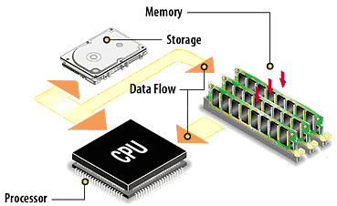
Process [1]
An internal process is the execution of one or more interruptable programs in a given storage area.
A program is a collection of instructions describing a computational process, whereas an internal process is the execution of these instructions in a given storage area.
A peripheral device is an item of hardware connected to the data channel.
A document is a collection of data stored on a physical medium.
An external process is the input/output of a given document.

Slide 6
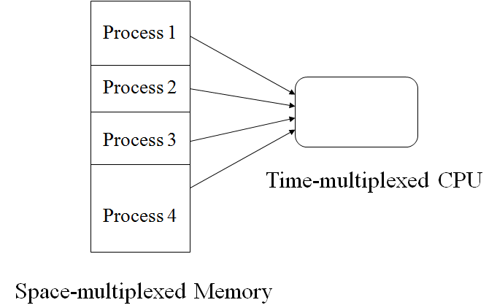
Multiprogramming System
In multiprogramming systems, the running task keeps running until it performs an operation that requires waiting for an external event or until the computer's scheduler forcibly swaps the running task out of the CPU.
Only one program at a time is able to get the CPU for executing its instructions (i.e., there is at most one process running on the system) while all the others are waiting their turn.
Multiprogramming and communication between internal and external processes are coordinated by the system nucleus – an interrupt response program with complete control of input/output, storage protection, and the interrupt system.
Multiprogramming systems are designed to maximize CPU usage.

Slide 7
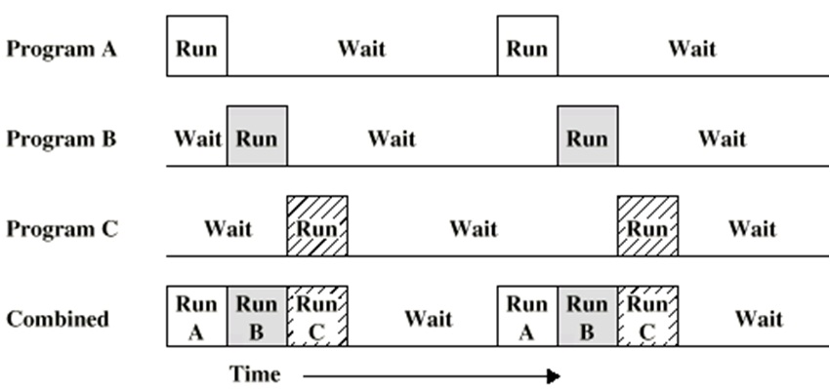
3 Programs and 1 CPU Example

Slide 8
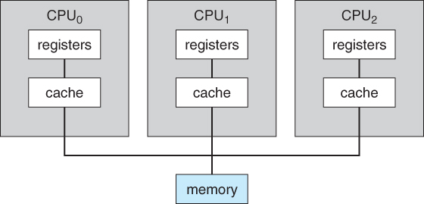
Multiprocessing
Multiprocessing refers to executing multiple processes at the same time.
Multiprocessing refers to the hardware (i.e., the CPU units) rather than the software (i.e., running processes).
If the underlying hardware provides more than one processor then that is multiprocessing.

Slide 9
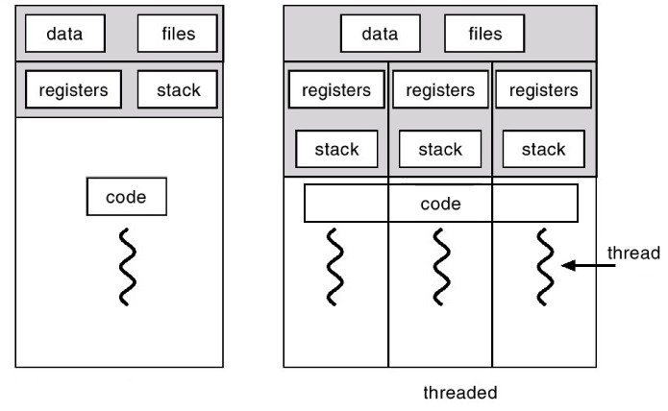
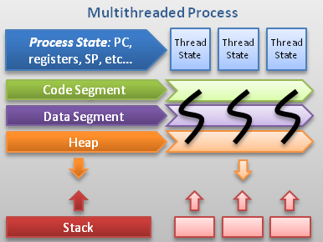
Thread [2]
Process has its own separated address space.
A thread is an execution path (code segment) that can proceed independently of others. Thread uses some shared address space.
With a single-threaded program, just one thread runs in the process’s isolated environment and so that thread has exclusive access to it.
With a multithreaded program, multiple threads run in a single process, sharing the same execution environment (memory, in particular).

Slide 10
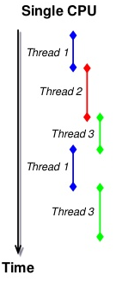
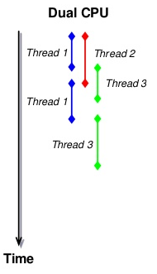
Multitasking and Multithreading
Multitasking refers to multiple tasks (processes, threads) running (apparently) simultaneously by sharing the CPU time.
Multithreading is an execution model that allows a single process to have multiple code segments (i.e., threads) run concurrently within the “context” of that process.
Multitasking and multithreading running on one CPU vs. multiprocessing and multiprogramming.
Multitasking and multithreading running on multiple CPUs vs. multiprogramming and multiprocessing.
Processes
Threads
CPUs

Slide 11
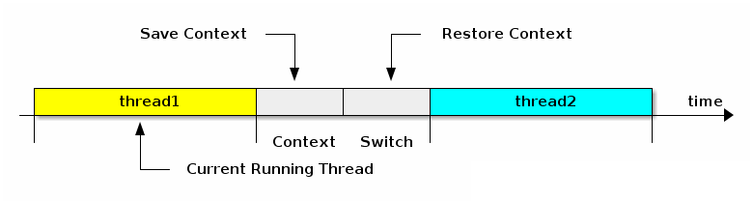
Context Switching
Process context switching involves switching the virtual memory address space: this includes memory addresses, mappings, page tables, and kernel resources.
Thread context switching is context switching from one thread to another in the same process (i.e. there is no need of switching the virtual memory address space as the “switcher” and the “switchee” threads share the same virtual address space).

Slide 12
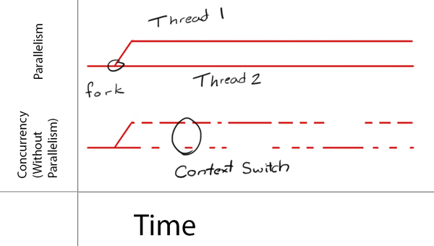
Concurrency vs. Parallelism

Slide 13


Slide 14
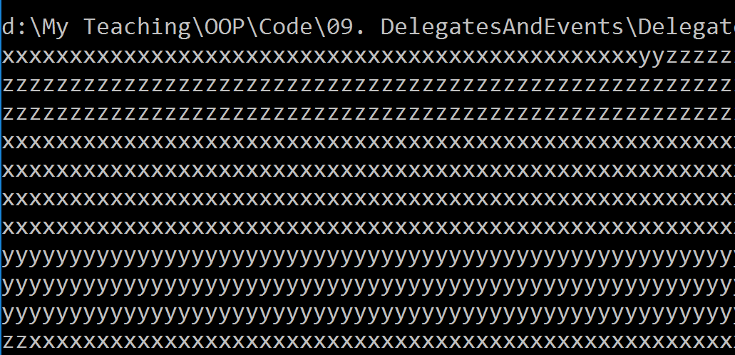
1. Create and Start a Thread

Slide 15

2. Wait for Thread

Slide 16
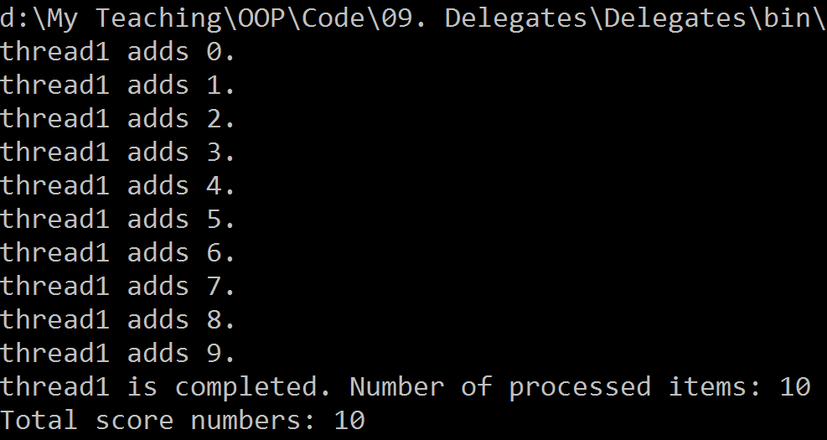
3. Pass an Argument to a Thread

Slide 17
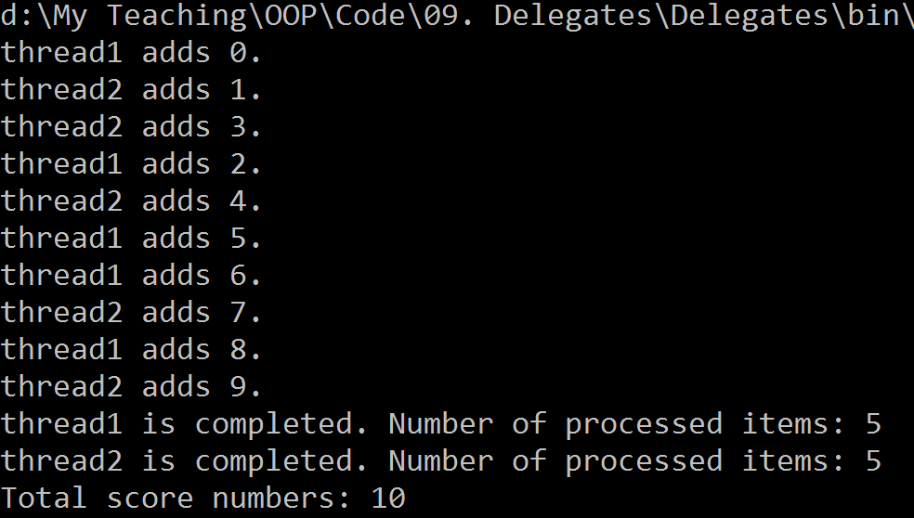
Execution Order

Slide 18
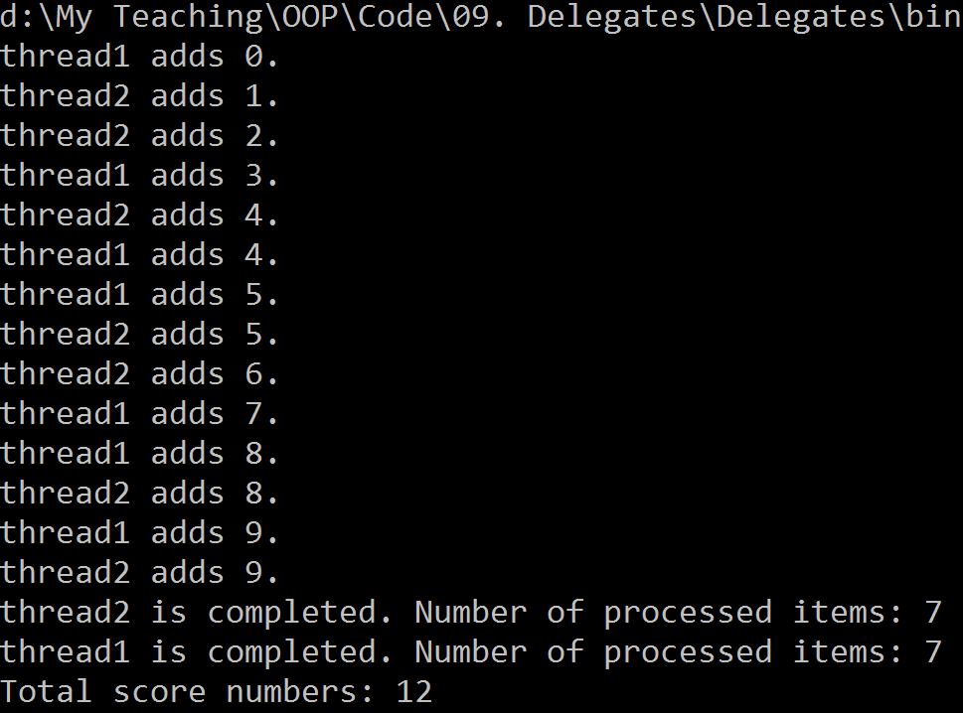
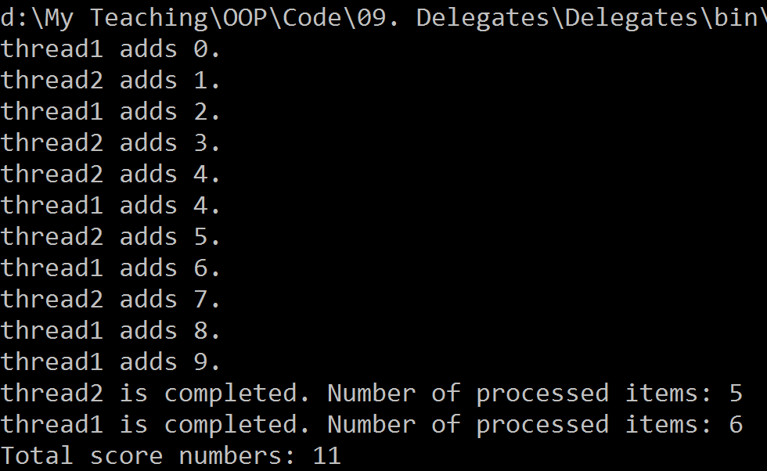
Non-Determinism
A nondeterministic algorithm is an algorithm that, even for the same input, can exhibit different behaviors on different runs.

Slide 19
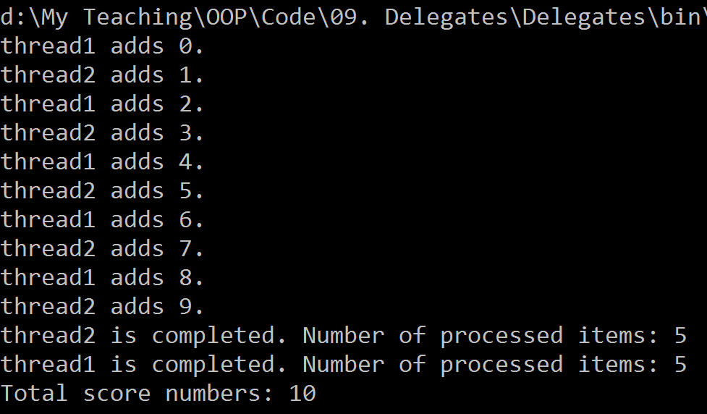
Exclusive Locking With lock Keyword
// Nothing special needed. Any object will do.
// However all threads must be aware about it.

Slide 20
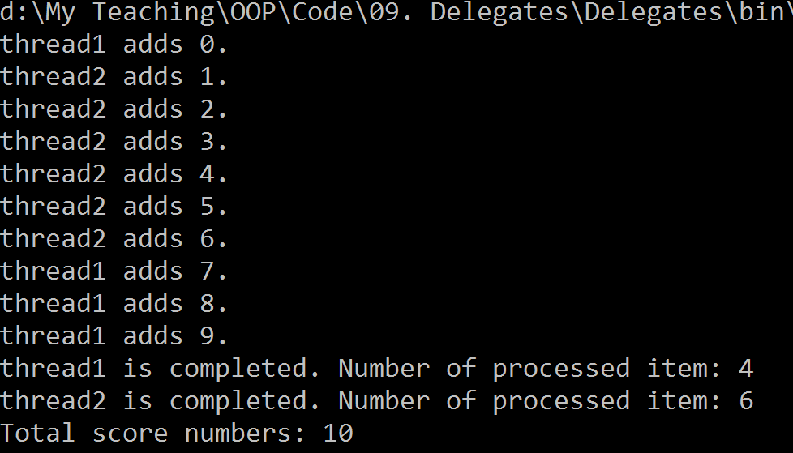
Exclusive Locking With Mutex Class

Slide 21

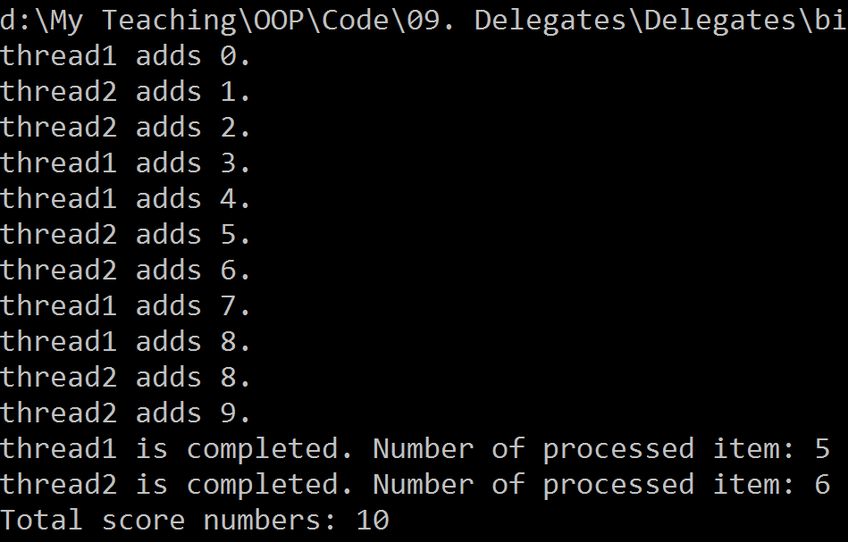
Non-exclusive Locking With Semaphore Class
Semaphores can be useful in limiting concurrency—preventing too many threads from executing a particular piece of code at once.

Slide 23
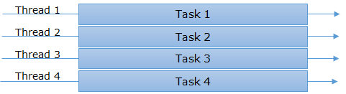
Synchronous Programming Model
In this programming model, a thread is assigned to one task and starts working on it.
Once the task completes then it is available for the next task.

Slide 24
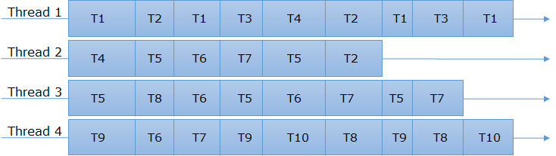
Asynchronous Programming Model
In contrary to synchronous programming model, here a thread once start executing a task it can hold it in mid, save the current state and start executing another task.

Slide 25



Asynchronous Programming [3]
Asynchronous programming means taking a piece of code and running it on a separate thread, freeing up the original thread to continue on and do other things while the task completes.
The opposite of asynchronous programming (sometimes called “asynchrony”) is synchronous programming.
Why asynchronous programming? – Modern computers have a lot of computational power, and users are expecting responsive user
interfaces.

Slide 26
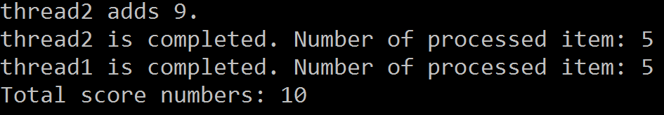
Event-Based Asynchrony
When will a thread finish its job?

Slide 27
ThreadPool
When will this thread start?
Is it a new thread?

Slide 28
Thread Limitations [2]
A thread is a low-level tool for creating concurrency, and as such, it has limitations, particularly the following:
Although it’s easy to pass data into a thread that you start, there’s no easy way to get a “return value” back from a thread that you Join. You need to set up some kind of shared field. And if the operation throws an exception, catching and propagating that exception is equally painful.
You can’t tell a thread to start something else when it’s finished; instead you must Join it (blocking your own thread in the process).
These limitations discourage fine-grained concurrency; in other words, they make it difficult to compose larger concurrent operations by combining smaller ones.
This in turn leads to greater reliance on manual synchronization (locking, signaling, and so on) and the problems that go with it.

Slide 30
Tasks
Compared to a thread, a Task is higher-level abstraction—it represents a concurrent operation that might or might not be backed by a thread.
The Task types were introduced in Framework 4.0 as part of the parallel programming library.
The easiest way to start a Task backed by a thread is with the static method Task.Run.
Task.Run returns a Task object that we can use to monitor its progress, rather like a Thread object.
Task.Run (() => Console.WriteLine ("Foo"));

Slide 31
Returning Values
Task has a generic subclass called Task<TResult>, which allows a task to emit a return value.
You can obtain a Task<TResult> by calling Task.Run with a Func<TRe⁠sult> delegate (or a compatible lambda expression) instead of an Action:
Task<int> task = Task.Run (() => { Console.WriteLine ("Foo"); return 3; });
You can obtain the result later by querying the Result property. If the task hasn’t yet finished, accessing this property will block the current thread until the task finishes:
int result = task.Result; // Blocks if not already finished
Console.WriteLine (result); // 3

Slide 32
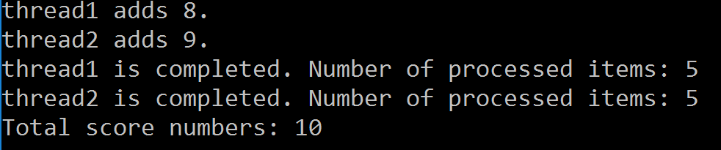
Task Example
Returned values
Exception handling

Slide 33
Continuations
A continuation says to a task, “When you’ve finished, continue by doing something else.”
A continuation is usually implemented by a callback that executes once upon completion of an operation.

Slide 34
Continuation Example
Task<int> primeNumberTask = Task.Run (() =>
Enumerable.Range (2, 3000000).Count (n =>
Enumerable.Range (2, (int)Math.Sqrt(n)-1).All (i => n % i > 0)));
var awaiter = primeNumberTask.GetAwaiter();
awaiter.OnCompleted (() =>
{
int result = awaiter.GetResult();
Console.WriteLine (result); // Writes result
});

Slide 35
Awaiter
Calling GetAwaiter on the task returns an awaiter object whose OnCompleted method tells the antecedent task (primeNumberTask) to execute a delegate when it finishes (or faults).
It’s valid to attach a continuation to an already-completed task, in which case the continuation will be scheduled to execute right away.
An awaiter is any object that exposes the two methods that we’ve just seen (OnCompleted and GetResult) and a Boolean property called IsCompleted. There’s no interface or base class to unify all of these members.

Slide 36
ContinueWith Example
Task<int> primeNumberTask = Task.Run (() =>
Enumerable.Range (2, 3000000).Count (n =>
Enumerable.Range (2, (int)Math.Sqrt(n)-1).All (i => n % i > 0)));
primeNumberTask.ContinueWith (antecedent =>
{
int result = antecedent.Result;
Console.WriteLine (result); // Writes 123
});

Slide 37
ContinueWith
ContinueWith itself returns a Task, which is useful if you want to attach further continuations.
However, you must deal directly with AggregateException if the task faults, and write extra code to marshal the continuation in UI applications.
And in non-UI contexts, you must specify
TaskContinuationOptions.ExecuteSynchronously if you want the continuation to execute on the same thread; otherwise it will bounce to the thread pool.
ContinueWith is particularly useful in parallel programming scenarios.

Slide 38
await Keyword
The await keyword simplifies the attaching of continuations.
Starting with a basic scenario, the compiler expands this:
var result = await expression;
statement(s);
into something functionally similar to this:
var awaiter = expression.GetAwaiter();
awaiter.OnCompleted (() =>
{
var result = awaiter.GetResult();
statement(s);
});

Slide 39
async Modifier
Task<int> GetPrimesCountAsync (int start, int count)
{
return Task.Run (() =>
ParallelEnumerable.Range (start, count).Count (n =>
Enumerable.Range (2, (int)Math.Sqrt(n)-1).All (i => n % i > 0)));
}
With the await keyword, we can call it as follows:
async void DisplayPrimesCount()
{
int result = await GetPrimesCountAsync (2, 1000000);
Console.WriteLine (result);
}
The async modifier instructs the compiler to treat await as a keyword rather than an identifier should an ambiguity arise within that method

Slide 41
What is a SynchronizationContext?
SynchronizationContext is a .NET abstraction that controls how and where code resumes after an await.
Think of it as a traffic cop for continuations — after an await, it decides what thread or context your code runs on next.

Slide 42
Why does it exist?
Because some environments must run code on a specific thread:
Environment | Why SynchronizationContext matters
WinForms/WPF | UI updates must happen on the UI thread
ASP.NET WebForms | Page/request lifecycle state is thread-bound
Console apps | Don’t care — no context, so null
ASP.NET Core | Also don’t care — context is stripped, null by default

Slide 43
Example in WinForms
private async void button1_Click(object sender, EventArgs e)
{
textBox1.Text = "Starting...";
await Task.Delay(1000); // Simulate async work
textBox1.Text = "Done!";
}
What happens here:
The method starts on the UI thread.
Task.Delay suspends execution and returns control to the UI thread.
After the delay, .NET schedules the continuation (textBox1.Text = "Done!") to run on the same UI thread.
This works because WinForms installs a SynchronizationContext that captures and uses the UI thread.

Slide 44
What if we block instead of await
private void button1_Click(object sender, EventArgs e)
{
var task = Task.Delay(1000);
task.GetAwaiter().GetResult(); // ⚠️ Blocks the UI thread
textBox1.Text = "Done!";
}
Now the UI thread is blocked. The continuation from Task.Delay tries to run on the same UI thread, but it cannot — because that thread is stuck waiting. The continuation is dead in the water.
Result: UI freeze or deadlock.
Conclusion: Avoid using task.GetAwaiter().GetResult();

Slide 45
Example in ASP.NET Web Forms
protected async void Page_Load(object sender, EventArgs e)
{
label1.Text = "Waiting...";
await Task.Delay(1000);
label1.Text = "Done!";
}
This works fine. Page_Load is async, and after 1 second, the continuation (label1.Text = "Done!") runs — on the original request-handling thread.
ASP.NET Web Forms installs a SynchronizationContext that ensures the continuation goes back to that thread.

Slide 46
Now, block instead of await
protected void Page_Load(object sender, EventArgs e)
{
var task = Task.Delay(1000);
task.GetAwaiter().GetResult(); // ⚠️ Uh oh
label1.Text = "Done!";
}
Page_Load starts.
Task.Delay(1000) starts a timer.
.GetAwaiter().GetResult() blocks the request-handling thread.
When the delay is over, .NET wants to resume the continuation on the same thread.
But it is blocked, waiting.
Deadlock.
Conclusion: Avoid using task.GetAwaiter().GetResult();

Slide 47
How does it actually work?
public class SynchronizationContext
{
public virtual void Post(SendOrPostCallback d, object state) { ... }
public virtual void Send(SendOrPostCallback d, object state) { ... }
}
Key methods:
Post: Schedules work asynchronously.
Send: Schedules work synchronously (blocking).
Frameworks like WinForms, WPF, and ASP.NET override this to post to their dispatcher/thread.

Slide 48
Where is SynchronizationContext used?
Framework | Installed SynchronizationContext
WinForms | WindowsFormsSynchronizationContext
WPF | DispatcherSynchronizationContext
ASP.NET | AspNetSynchronizationContext
ASP.NET Core | ❌ None (SynchronizationContext.Current == null)
Console app | ❌ None

Slide 49
Rule of Thumb
✔ Use await — async all the way.
❌ Avoid .GetAwaiter().GetResult() unless you're writing a Main() method in a console app or doing very controlled sync interop.
Why .GetAwaiter().GetResult() is dangerous
It can cause deadlocks Especially in:
ASP.NET (classic)
WinForms
WPF Where there's a SynchronizationContext that tries to resume on a blocked thread.

Slide 50

Thank You & See You Again

